Slide 1
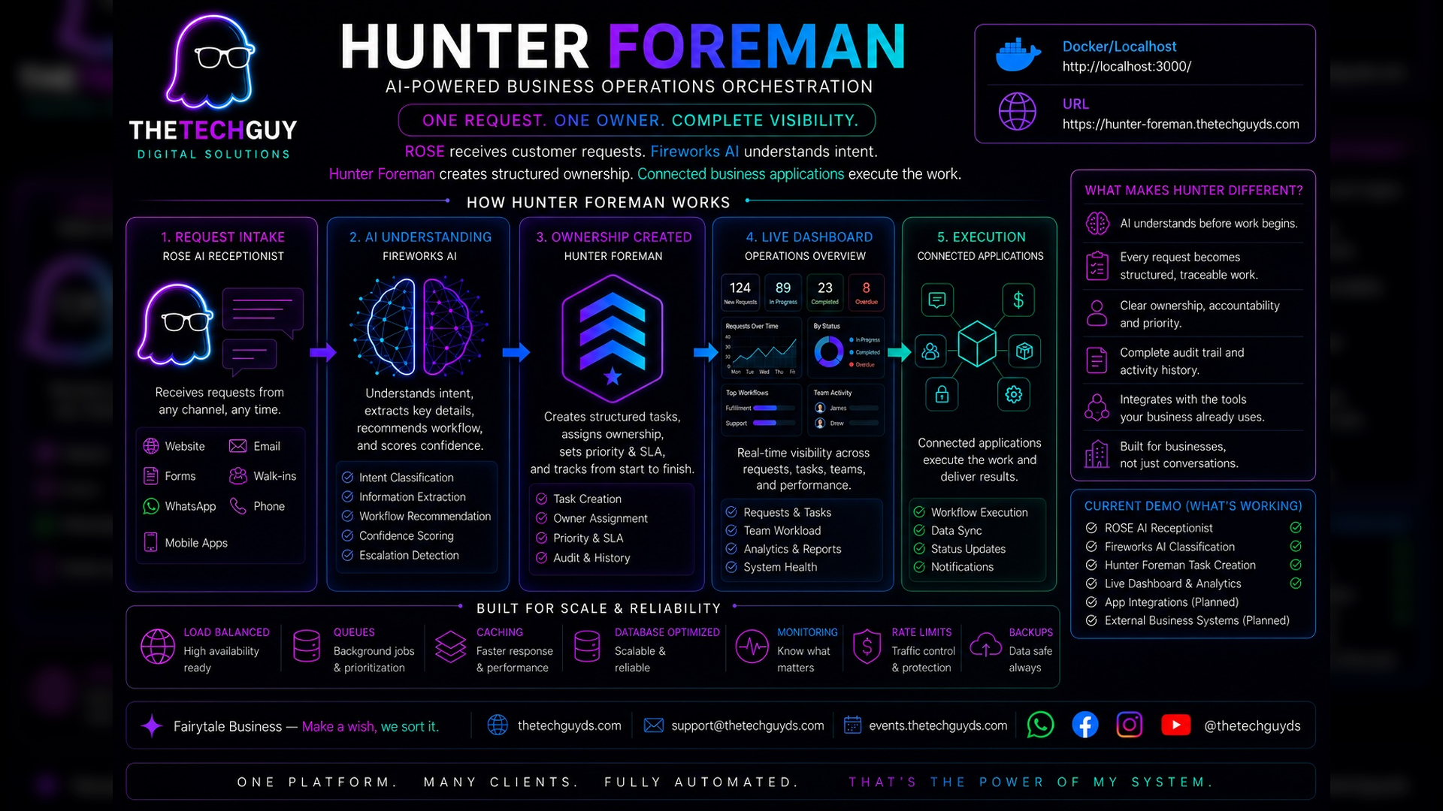

Slide 2
The Problem
Customer requests arrive everywhere. Ownership often does not.
Fragmented intake
Work gets lost
No clear visibility
Websites, email, WhatsApp, social media, staff messages and walk-ins create scattered requests.
Without structured ownership, requests can be forgotten, duplicated, delayed, or routed to the wrong person.
Managers cannot easily see who owns the work, what changed, and what should happen next.
Hunter Foreman turns every customer request into owned, traceable work.
BUILT FOR BUSINESS OPERATIONS — NOT JUST CONVERSATION
HUNTER FOREMAN • ONE REQUEST. ONE OWNER. COMPLETE VISIBILITY.
02

Slide 3
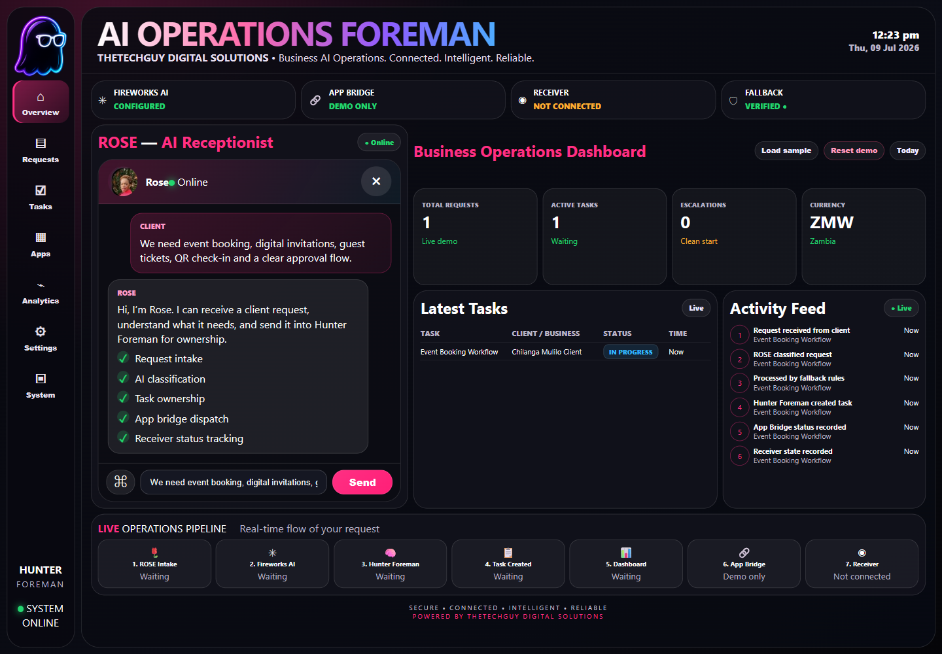
The Solution
An AI operations foreman that converts intent into ownership.
ROSE intake
A client request is received through a receptionist-style interface.
AI understanding
Fireworks classifies intent, workflow, confidence, and escalation signals.
Structured ownership
Hunter Foreman creates a task, lifecycle, owner path, and dashboard visibility.
RESULT: WORK THAT IS OWNED, TRACKED, AND VISIBLE
HUNTER FOREMAN • ONE REQUEST. ONE OWNER. COMPLETE VISIBILITY.
03

Slide 4
How Hunter Foreman Works
A request becomes structured work through a visible operations chain.
Customer
ROSE AI Receptionist
Fireworks AI
Hunter Foreman
Dashboard
App Bridge
Connected Apps
The conversation is only the beginning. The output is a structured task with ownership, priority, lifecycle, dashboard state, and optional application dispatch.
HUNTER FOREMAN • ONE REQUEST. ONE OWNER. COMPLETE VISIBILITY.
04

Slide 5
Fireworks AI Integration
Semantic understanding converts raw requests into structured operations signals.
accounts/fireworks/models/gpt-oss-120b
Fallback is explicit
Intent classification
Workflow recommendation
Confidence scoring
Escalation detection
Structured output for task creation
If provider credentials are not configured, the demo uses deterministic rules instead of pretending live AI is available.
Evidence matches implementation
Proof artifacts and demo behavior distinguish Fireworks-backed classification from deterministic local fallback.
Why it matters
Judges can see the AI boundary, the business workflow boundary, and proof artifacts.
HUNTER FOREMAN • ONE REQUEST. ONE OWNER. COMPLETE VISIBILITY.
05

Slide 6
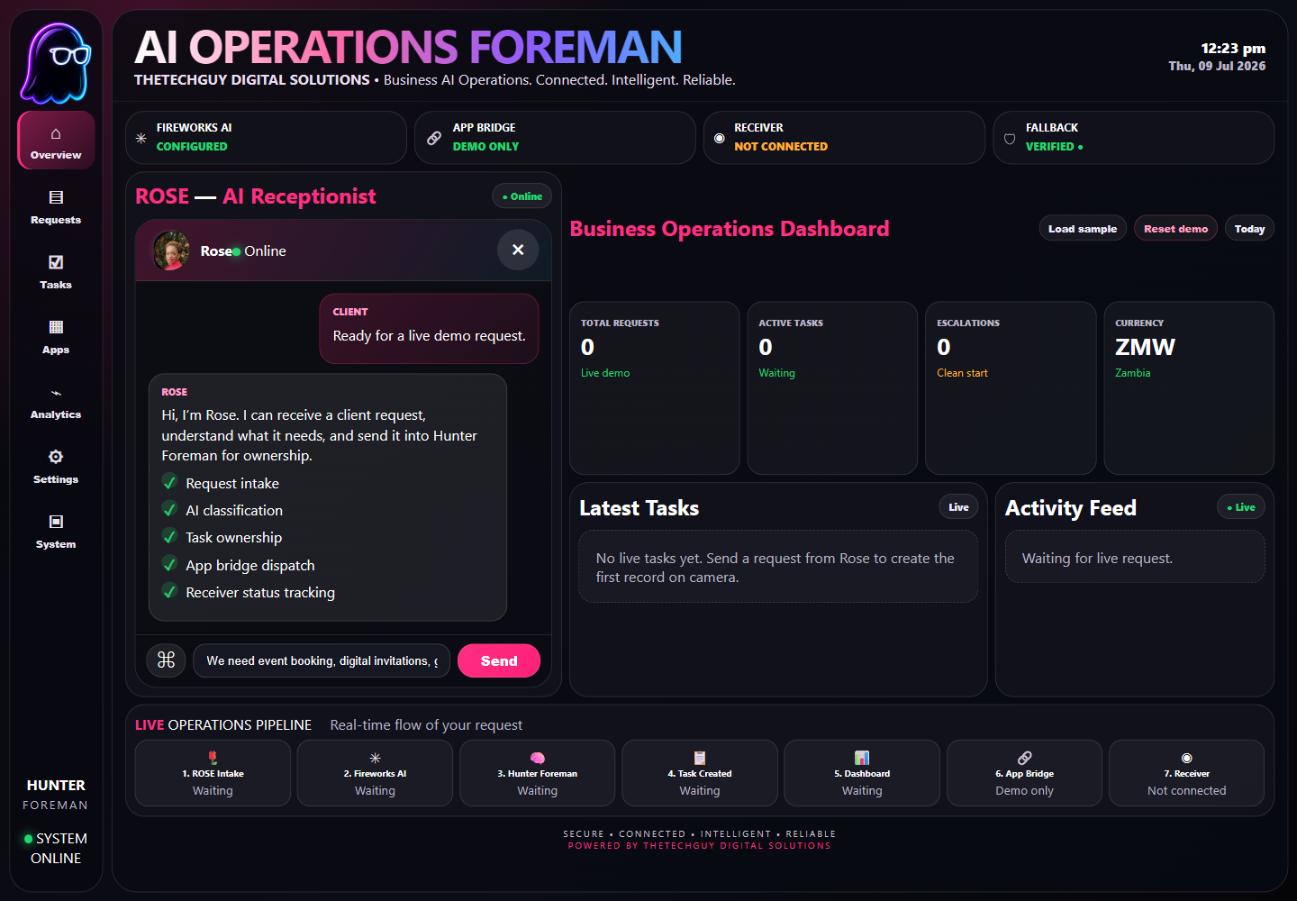
Demo Flow
From ROSE request to dashboard visibility.
Before request
After request created
HUNTER FOREMAN • ONE REQUEST. ONE OWNER. COMPLETE VISIBILITY.
06

Slide 7
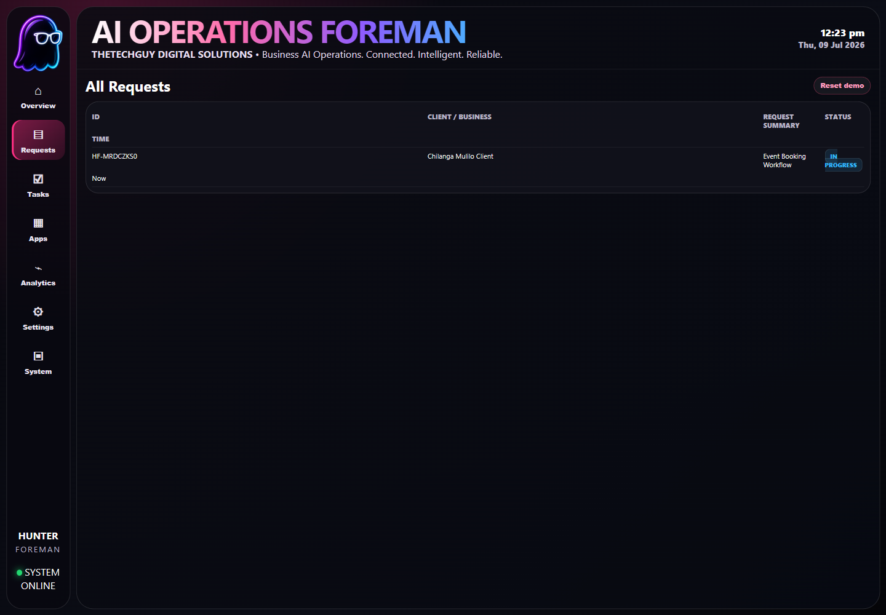
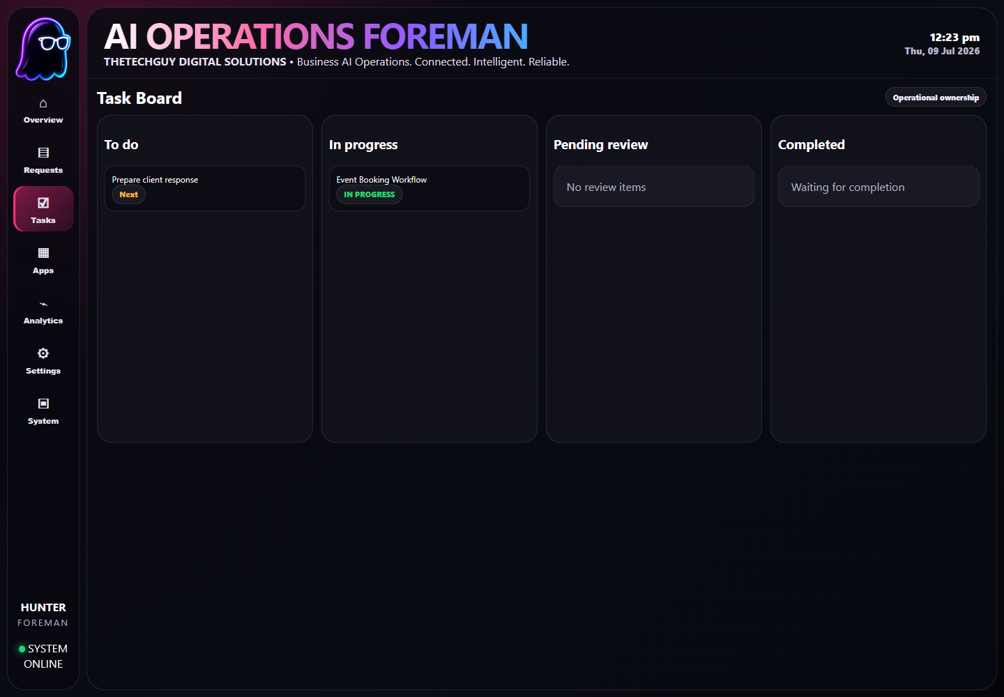
Proof of Ownership
Requests become task-board work instead of disappearing in chat history.
REQUEST LOG
TASK BOARD
HUNTER FOREMAN • ONE REQUEST. ONE OWNER. COMPLETE VISIBILITY.
07

Slide 8
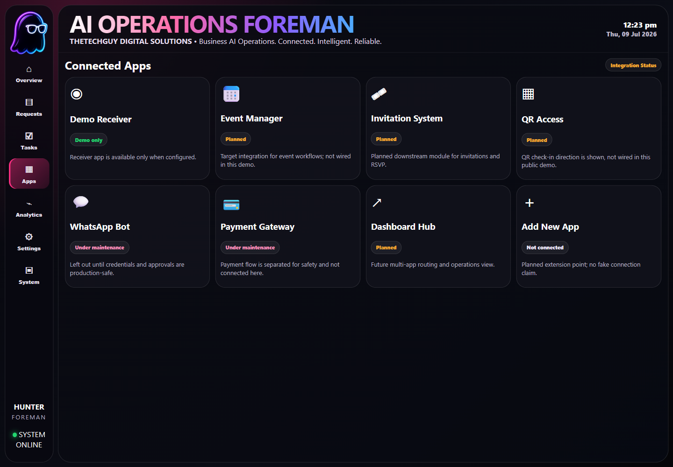
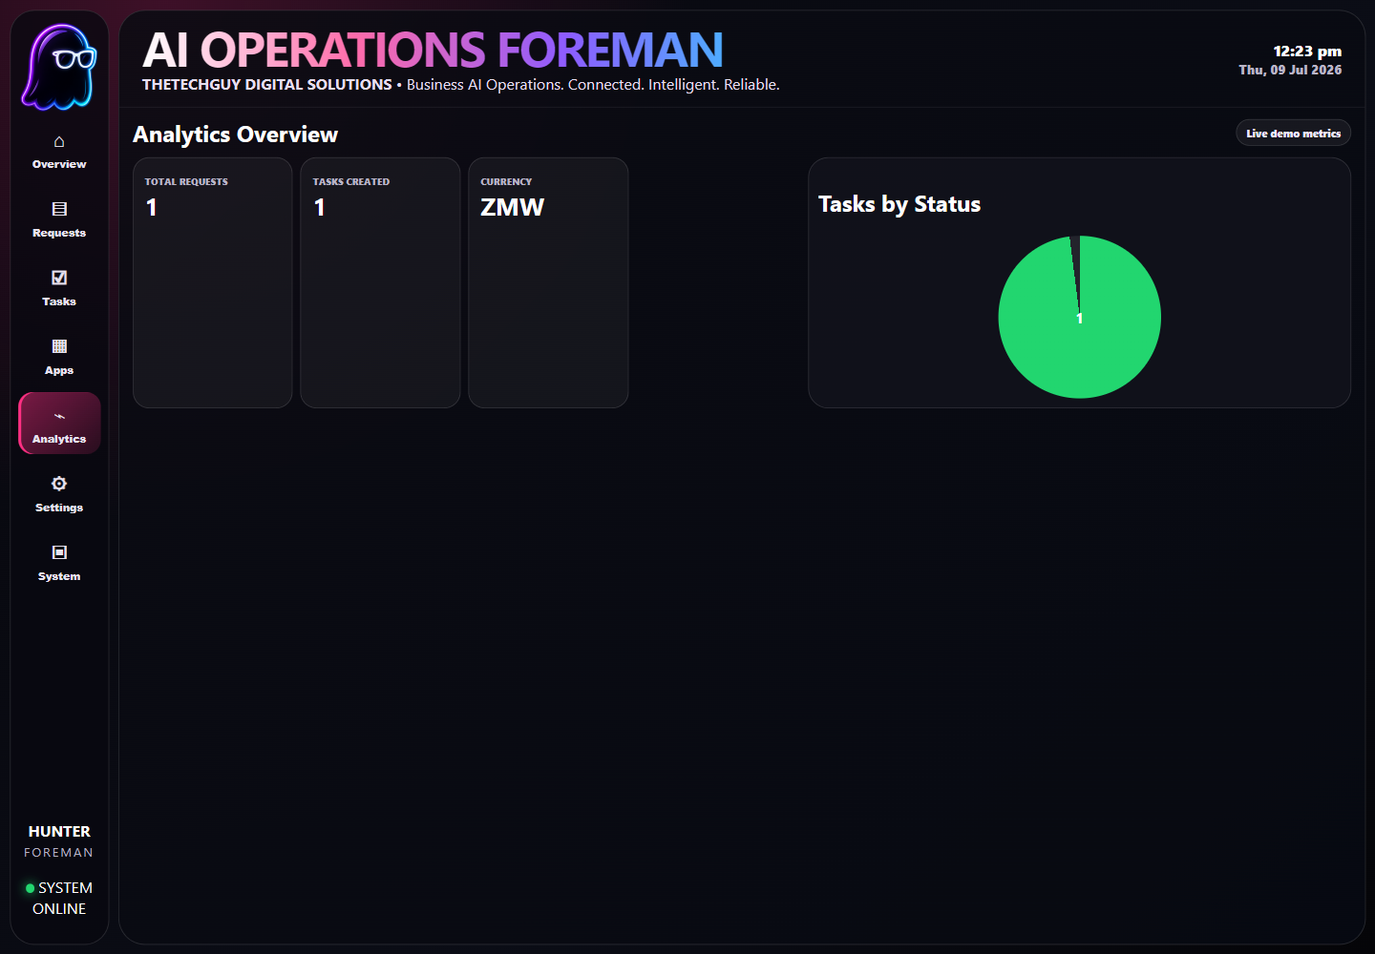
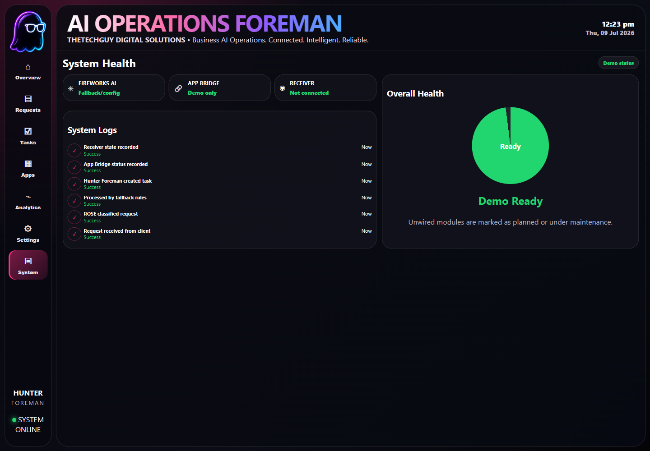
Operations Depth
Integrations are visible, but unfinished modules are not falsely presented as live.
Connected Apps
Analytics
System Health
Planned, under-maintenance, demo-only, and not-connected states are shown honestly inside the product UI.
HUNTER FOREMAN • ONE REQUEST. ONE OWNER. COMPLETE VISIBILITY.
08

Slide 9
Verification & Container Proof
Submission evidence is packaged to support every significant claim.
Containerized app
Proof package
Tests
Dockerfile and docker-compose run the demo on port 3000.
Screenshots, demo walkthrough, API health, App Bridge state, and checksums.
Smoke test, syntax checks, and Fireworks live classification proof.
Clean clone command path
README visuals are WebP for fast loading
Original proof evidence remains traceable
Fallback behavior is documented instead of hidden
git clone https://github.com/jaydumisuni/hunter-foreman.git
cd hunter-foreman
docker compose up --build
open http://localhost:3000
HUNTER FOREMAN • ONE REQUEST. ONE OWNER. COMPLETE VISIBILITY.
09

Slide 10
Roadmap
From working demo to multi-business operations platform.
Current
Business integrations
Platform expansion
Working AI operations demo with ROSE intake, Fireworks classification path, task ownership, dashboard visibility, and proof artifacts.
Connect real WhatsApp, payment, event, invitation, QR access, and business-specific receivers.
Multi-business deployment, stronger App Bridge contracts, additional AI providers, and production monitoring.
Track 3 — product/startup-oriented AI operations infrastructure
ONE PLATFORM. MANY CLIENTS. FULLY AUTOMATED.
HUNTER FOREMAN • ONE REQUEST. ONE OWNER. COMPLETE VISIBILITY.
10

